Slide 1
SIGN LANGUAGE GESTURE RECOGNITION
SOUMENDU CHATTERJEE
PGA21

Slide 2
PROBLEM STATEMENT
In day-to-day life, computers are becoming a norm. But there are people who are not educated enough to use them. For them using computers even for the basic of requirements is a mountainous task. Also there are specially challenged people who are only know to interact with sign language from their childhood and cannot understand alphabets on the keyboard.
This project is a stepping stone to overcome the problems faced by some unfortunate citizens so they can interact with computers at their workplace or at school, bus stop, railway station etc. and hence can use as easily as we do.

Slide 3
GOAL
The goal of this project is to recognize the signs and symbols shown by people so the application or the device can understand as what is conveyed and hence give the necessary services required.
This project recognizes 7 kinds of signs that are most commonly used in daily basis. The user shows up his/her hand depicting a symbol and the application in which the following project would be deployed will recognize the word and will process accordingly.
A graphical user interface authorizing the initialization of the application is to be developed for necessary security purposes.

Slide 4
APPROACH
Almost 12000 train images and 8000 validation images were collected and categorized so as to train the model efficiently adapting to different ways of showing up hands using Video Capture in OpenCV library.
A model was built and the images were fed into the model and trained.
At the end, when the hand is shown depicting a particular sign or symbol in front of the webcam, the system will predict as to what the user is trying to convey in real time.

Slide 5
IMAGE RECOGNITION MODEL
The image recognition model in this project is based on Convolution Neural Network.
CNN is a specialized type of neural network model designed for working with two-dimensional image data. They can also be used with 1-D and 3-D data.
CNN uses convolution technique i.e. multiplies an array of input data with 2-D array of weights also called as filter or kernel. We can add as many as filters we want based on our requirement.
After getting the dot product between filter and input, we then take the maximum or average of values in the resultant matrix. As a result, the input image is broken down into number of small layers.
The last step involves flattening which is nothing but making the array of numbers into 1-D to be fed into the neural network model.
With each epoch of the neural network, this whole process of CNN undergoes.

Slide 6
CHALLENGES FACED
For the Image Recognition to work efficiently, the model needs to be trained very well adapting to different conditions. As a result, hand images were captured from all the angles which will result in an efficient prediction.
Background becomes an important factor in image recognition as a change in background will result in the system interpreting an entire different image. Due to this, all images are blurred and thresholds are applied to them so as to eliminate the effect of color from the images resulting in lesser effect of the background.

Slide 7
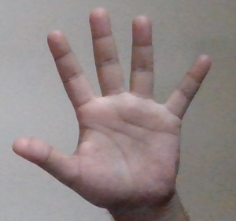
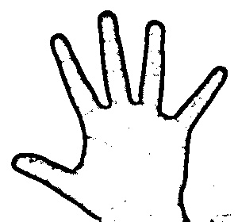
IMAGE COMPARISON between original and image after blurring and applying threshold
ORIGINAL
AFTER PROCESSING

Slide 8
UNSOLVED CHALLENGES
The effect of background still remains an issue with the project. Reducing this effect has been tried very hard by blurring the background and eliminating colors which has helped in near efficient prediction. But removing the effect completely is still needed to achieve. Too much noisy backgrounds can trigger inaccurate predictions.

Slide 9
POSSIBLE FUTURE APPLICATIONS
In future, tickets for travelling will be completely computerized on stations. Uneducated and hearing and speaking impaired can access these machines using a better version of the following model.
Food and beverage vending machines can use the following model to help people by using a certain set of hand signs and symbols if people are comfortable with typing.
This model can also be applied in personal computers at a basic level. So that until a person learns how to operate computers normally, the application using this model can help for the basic operations like opening a folder, typing, making spreadsheets etc.

Slide 10
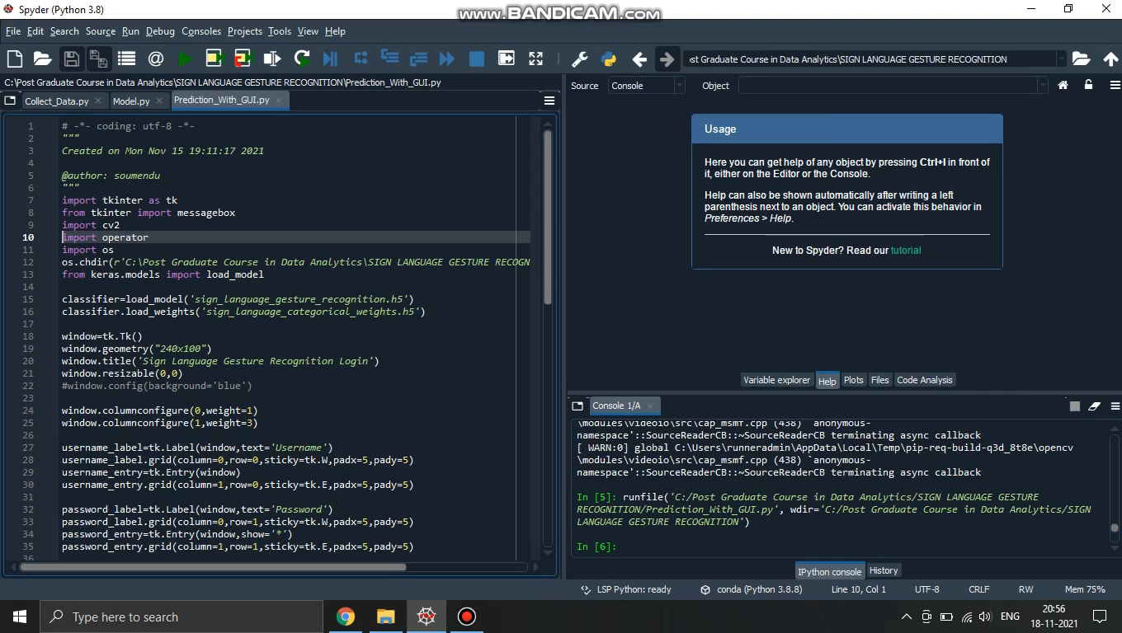
MODEL PERFORMANCE

